Slide 1


Capstone Project D: CYSA
Gustavo Nieves
Cohort 23C

Slide 2


Summary
Improve the security of their network. They specifically wish to implement a way to identify and log attacks against their web and production servers. After some research, you decide that installing an IDS/IPS would meet their needs.

Slide 3

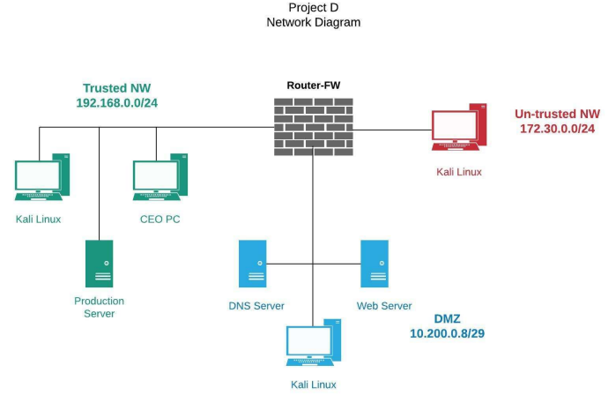
Network Diagram

Slide 4
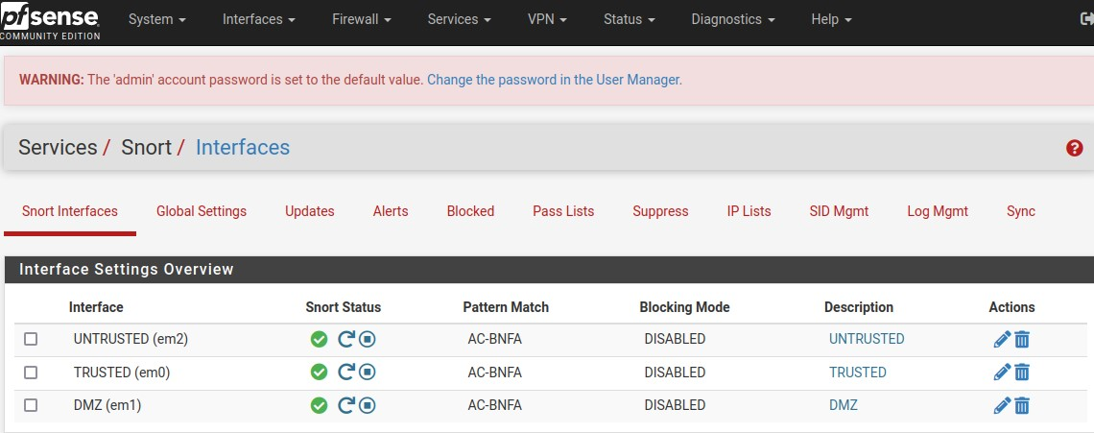
Snort

Slide 5

Why Snort?
Alert and log Suspicious activity on the untrusted and DMZ interfaces
Alert and log NMAP scanning and FTP connection

Slide 6
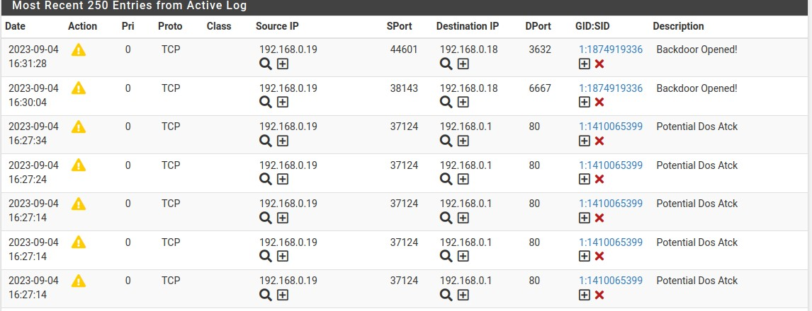
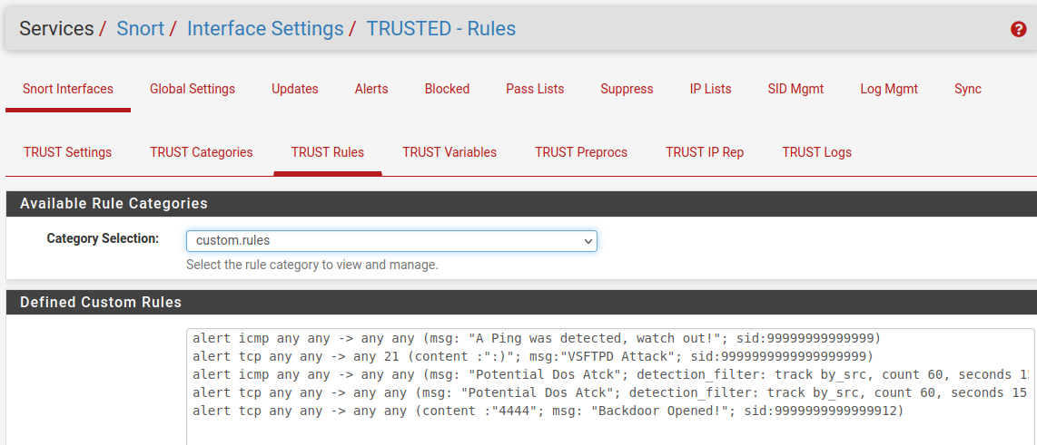
Alerts

Slide 7
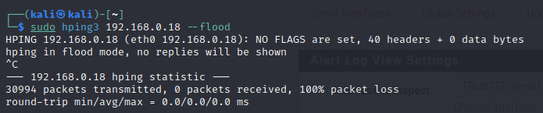
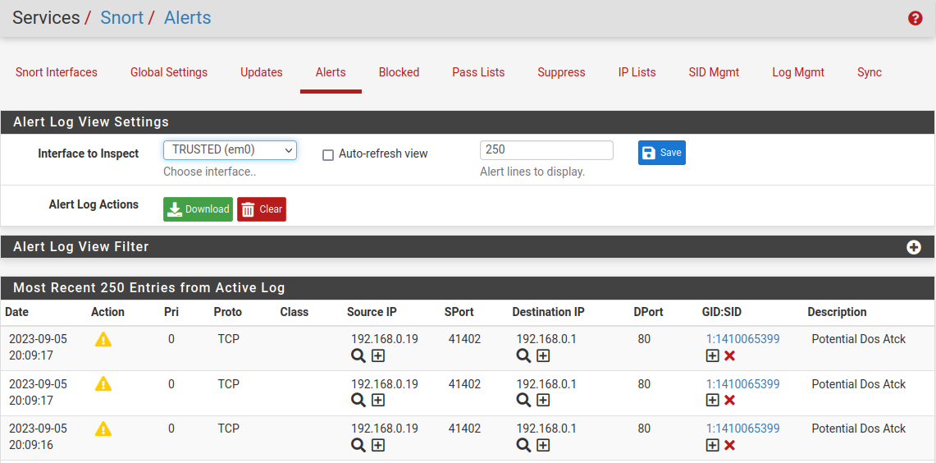
Snort Alert: Exploit

Slide 8
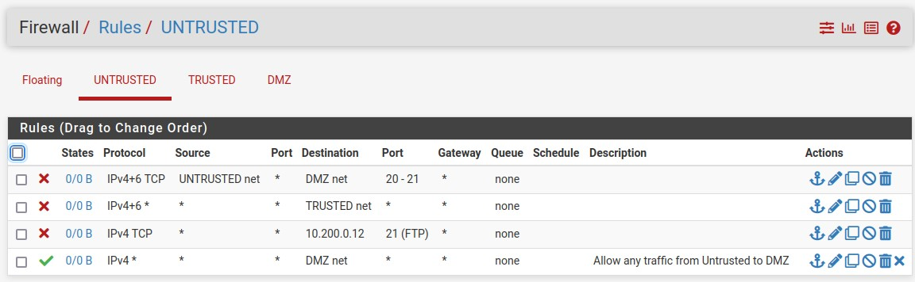
Firewall RuleS

Slide 9
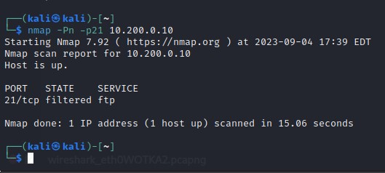
NMAP Scan

Slide 10

Recommendations
Use Customized Rule Sets: Tailor the rule sets to focus on the specific vulnerabilities and attacks relevant to the client
Monitoring and Alerting: Ensure that alerts are promptly reviewed and acted upon to respond to potential security incidents
Log Management and Retention: Set up a Log Management to collect, store, and Analyze IDS/IPS logs.
Incident Response Planning: Develop a response plan with the client to define roles and responsibilities, incident escalation procedures and steps to minimize security incidents.

